Slide 1

Introduction to AI
Lyernisha S R
Lecturer , FICT

Slide 2
Problem solving

Slide 3
Problem solving
Problem solving is the act of defining a problem; determining the cause of the problem; identifying, prioritizing, and selecting alternatives for a solution; and implementing a solution.
1. Define the problem
2.Analyse the problem
3.Identify the solutions
4.Choosing the best solution
5.Implementation of solution
6.Documentation

Slide 4
Problem Solving as Search
Problem solving is an important aspect of Artificial Intelligence
A problem can be considered to consist of a goal and a set of actions that can be taken to lead to the goal.
At any given time, we consider the state of the search space to represent where we have reached as a result of the actions we have applied so far.
For example, consider the problem of looking for a contact lens on a football field. The initial state is how we start out, which is to say we know that the lens is somewhere on the field, but we don’t know where.
If we use the representation where we examine the field in units of one square foot, then our first action might be to examine the square in the top-left corner of the field.
If we do not find the lens there, we could consider the state now to be that we have examined the top-left square and have not found the lens.
After a number of actions, the state might be that we have examined 500 squares, and we have now just found the lens in the last square we examined.
This is a goal state because it satisfies the goal that we had of finding a contact lens.

Slide 5
Search as a Technique for Problem Solving
In Artificial Intelligence, Search techniques are universal problem-solving methods
Problem-solving agents in AI mostly used these search strategies or algorithms to solve a specific problem and provide the best result.
Problem-solving agents are the goal-based agents.
Search is a method that can be used by computers to examine a problem space in order to find a goal.
A problem space can also be considered to be a search space because in order to solve the problem, we will search the space for a goal state.
There are a number of methods for examining a search space, and they are called search methods.
In general, searching refers to as finding target information or goal that is aimed.
Searching is of the most commonly used technique of problem solving in artificial intelligence.
The searching algorithms helps us to easily search for solutions that exist in the problem space.

Slide 6
Search Algorithm Terminologies
Search: Searching is a step-by-step procedure to solve a search-problem in a given search space. A search problem can have three main factors:
Search Space: Search space represents a set of possible solutions, which a system may have.
Start State: It is a state from where agent begins the search.
Goal test: It is a function which observe the current state and returns whether the goal state is achieved or not.
Search tree: A tree representation of search problem is called Search tree. The root of the search tree is the root node which is corresponding to the initial state.
Actions: It gives the description of all the available actions to the agent.
Transition model: A description of what each action do, can be represented as a transition model.
Path Cost: It is a function which assigns a numeric cost to each path.
Solution: It is an action sequence which leads from the start node to the goal node.
Optimal Solution: If a solution has the lowest cost among all solutions.

Slide 7
Properties of Search Algorithms
Completeness: A search algorithm is said to be complete if it guarantees to return a solution if at least any solution exists for any random input.
Optimality: If a solution found for an algorithm is guaranteed to be the best solution (lowest path cost) among all other solutions, then such a solution for is said to be an optimal solution.
Admissibility: In some cases, the word optimal is used to describe an algorithm that finds a solution in the quickest possible time, in which case the concept of admissibility is used in place of optimality. An algorithm is then defined as admissible if it is guaranteed to find the best solution.
Time Complexity: Time complexity is a measure of time for an algorithm to complete its task.
Space Complexity: It is the maximum storage space required at any point during the search, as the complexity of the problem.
Irrevocability: solutions that look good locally but are less favorable when compared with other solutions elsewhere in the search space.

Slide 8
Types of Search
There are two main approaches to searching a search tree
Data-driven search(Top-down approach) starts from an initial state and uses actions that are allowed to move forward until a goal is reached. This approach is also known as forward chaining.
Alternatively, search can start at the goal and work back toward a start state, by seeing what moves could have led to the goal state. This is goal-driven search(Bottom-up approach), also known as backward chaining.

Slide 9
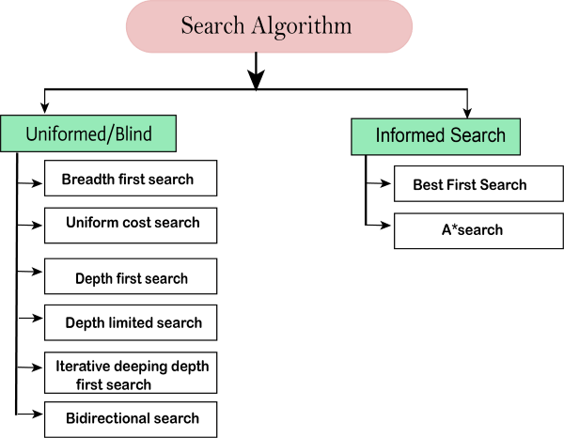
Types of search algorithms
Based on the search problems we can classify the search algorithms into uninformed (Blind search) search and informed search (Heuristic search) algorithms.

Slide 10
Uninformed/Blind Search:
The uninformed search does not contain any domain knowledge such as closeness, the location of the goal.
It operates in a brute-force way as it only includes information about how to traverse the tree and how to identify leaf and goal nodes.
Uninformed search applies a way in which search tree is searched without any information about the search space like initial state operators and test for the goal, so it is also called blind search.
It examines each node of the tree until it achieves the goal node.
It can be divided into five main types:
Breadth-first search
Depth-first search
Uniform cost search
Iterative deepening depth-first search
Bidirectional Search

Slide 11
Informed Search
Informed search algorithms use domain knowledge.
In an informed search, problem information is available which can guide the search. Informed search strategies can find a solution more efficiently than an uninformed search strategy. Informed search is also called a Heuristic search.
A heuristic is a way which might not always be guaranteed for best solutions but guaranteed to find a good solution in reasonable time.
Informed search can solve much complex problem which could not be solved in another way.
An example of informed search algorithms is a traveling salesman problem.
Greedy Search
A* Search

Slide 12
1. Breadth-first Search:
Breadth-first search is the most common search strategy for traversing a tree or graph. This algorithm searches breadthwise in a tree or graph, so it is called breadth-first search.
BFS algorithm starts searching from the root node of the tree and expands all successor node at the current level before moving to nodes of next level.
The breadth-first search algorithm is an example of a general-graph search algorithm.
Breadth-first search implemented using FIFO queue data structure.
Advantages:
BFS will provide a solution if any solution exists.
If there are more than one solutions for a given problem, then BFS will provide the minimal solution which requires the least number of steps.
Disadvantages:
It requires lots of memory since each level of the tree must be saved into memory to expand the next level.
BFS needs lots of time if the solution is far away from the root node.

Slide 13
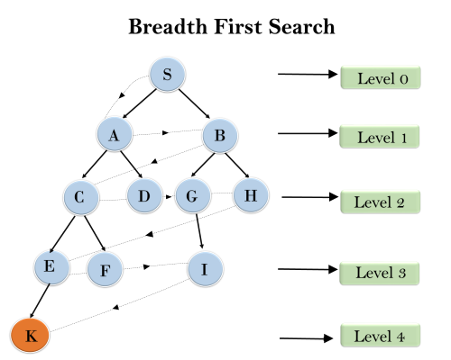
Example: BFS
In the below tree structure, we have shown the traversing of the tree using BFS algorithm from the root node S to goal node K.
BFS search algorithm traverse in layers, so it will follow the path which is shown by the dotted arrow, and the traversed path will be:
S---> A--->B---->C--->D---->G--->H--->E---->F---->I---->K

Slide 14
BFS Analysis
Time Complexity: Time Complexity of BFS algorithm can be obtained by the number of nodes traversed in BFS until the shallowest Node. Where the d= depth of shallowest solution and b is a node at every state.
T (b) = 1+b²+b³+.......+ b^{d}= O (b^{d})
Space Complexity: Space complexity of BFS algorithm is given by the Memory size of frontier which is O(bd).
Completeness: BFS is complete, which means if the shallowest goal node is at some finite depth, then BFS will find a solution.
Optimality: BFS is optimal if path cost is a non-decreasing function of the depth of the node.

Slide 15
2. Depth-first Search
Depth-first search is a recursive algorithm for traversing a tree or graph data structure.
It is called the depth-first search because it starts from the root node and follows each path to its greatest depth node before moving to the next path.
DFS uses a stack data structure for its implementation.
The process of the DFS algorithm is similar to the BFS algorithm.
Advantage:
DFS requires very less memory as it only needs to store a stack of the nodes on the path from root node to the current node.
It takes less time to reach to the goal node than BFS algorithm (if it traverses in the right path).
Disadvantage:
There is the possibility that many states keep re-occurring, and there is no guarantee of finding the solution.
DFS algorithm goes for deep down searching and sometimes it may go to the infinite loop.

Slide 16
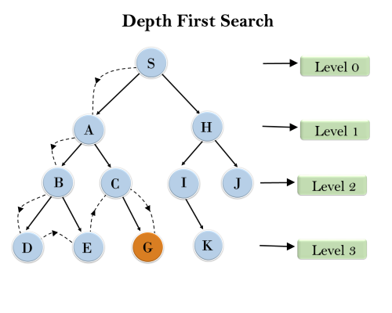
Example: DFS
In the given search tree, we have shown the flow of depth-first search, and it will follow the order as:
Root node--->Left node ----> right node.
It will start searching from root node S, and traverse A, then B, then D and E, after traversing E, it will backtrack the tree as E has no other successor and still goal node is not found. After backtracking it will traverse node C and then G, and here it will terminate as it found goal node.

Slide 17
DFS- Analysis
Completeness: DFS search algorithm is complete within finite state space as it will expand every node within a limited search tree.
Time Complexity: Time complexity of DFS will be equivalent to the node traversed by the algorithm. It is given by:
T(n)= 1+ n²+ n³ +.........+ n^{m}=O(n^{m})
Where, m= maximum depth of any node and this can be much larger than d (Shallowest solution depth)
Space Complexity: DFS algorithm needs to store only single path from the root node, hence space complexity of DFS is equivalent to the size of the fringe set, which is O(bm).
Optimal: DFS search algorithm is non-optimal, as it may generate a large number of steps or high cost to reach to the goal node.

Slide 18
Comparison of DFS and BFS

Slide 19
Thankyou!

